Slide 1
West End “What ifs . . .”
→ See Sample Homework on next page.
1. What are your “What Ifs” for the west end. Add your dream here. Type directly into this box.
2.
3.
→ Please email homework to Katy Zeigler at info@westcolfax.org. Use this page or send response as a separate email. Write West End What Ifs in the subject line. Homework due by Dec. 31. Include photos, if you wish.
Thank you !

Slide 2
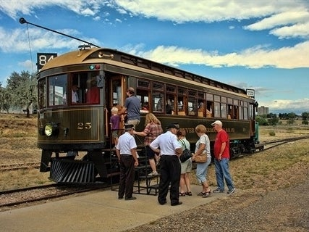
West End “What ifs . . .”
SAMPLE HOMEWORK!
. . . an open-air retro trolley shuttled people back and forth between 40 West Arts District and a new West End Entertainment District that included shops and restaurant along Quail Street?
. . . we connected with our past and rekindled “Colfax Cruising” to host a major must-see outdoor festival celebrating both classic cars and new electric/hybrid concepts?
. . . a new, large westside park was home Trolley Car 25 that families could not only see but ride as well—with a museum, gift shop, and authentic time-period restaurant

